Slide 1
Custom Memory Management Layer
CS599 - Large Scale Data Structures
Justin Poehnelt, Mike Deberg, Evan Bolyen, Nakai MacCarty, Antonio Rios

Slide 2
Background
In particular, 64-bit pointer architectures are capable of addressing much more RAM than what is typically available on today’s machines (even high performance clusters), wasting significant space in pointer-heavy data structures.
The cost of keeping multiple pointers within each node of the trie makes it cost-prohibitive when trying to contain read sets consisting of millions to billions of unique sequence fragments.
Thanks to C/C++ accessibility to low level programming it allows us to control how memory is allocated and deallocated in our code. Providing use with the tool to better improve how 64 bit pointers can be translated into pointers of arbitrary (pre-specified) size.

Slide 3
Objective
Design and implement a custom memory management tool / class / layer to translate 64 bit pointers into pointers of arbitrary (pre-specified) size.

Slide 4
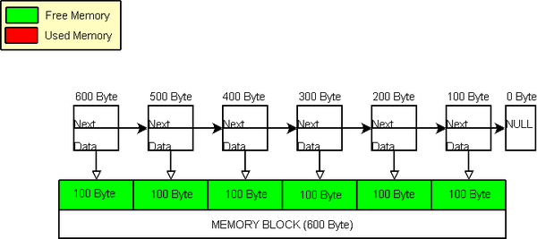
Solution Overview
Custom Memory Allocator
Compact Smart Pointer
Override Node Class Operators
Structure Padding
Source: Figure1: Memory Pool

Slide 5
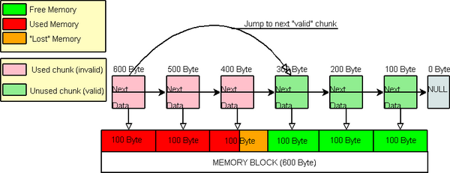
Strategies Overview
Request of large memory chunks
Optimize for common request sizes
Pool deleted memory in containers.
Source: Figure 2: Memory Pool

Slide 11
Theoretical Performance

Slide 12
Benchmarks

Slide 13
Further Enhancements

Slide 14
Issues

Slide 15
Conclusion

